Slide 1

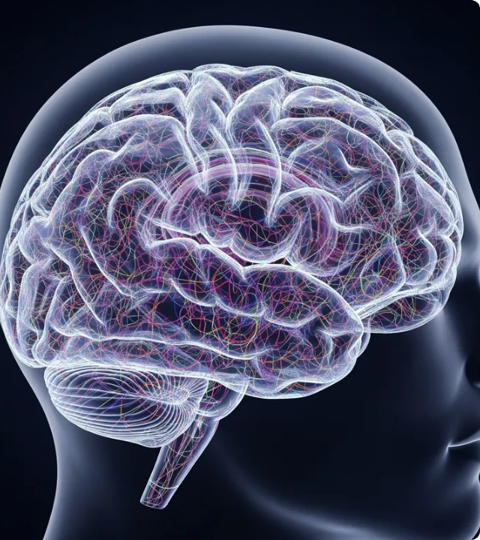
AI-Powered Multimedia Production
Traditionally, producing a song, music video, and cover images requires multiple specialists, significant time, and a large budget.
This project resolves that challenge by using AI tools to automate and heavily simplify the workflow.
The result makes high-quality music production and stunning visual design.

Slide 2




Core AI Approaches (Which AI types did I use?)
Generative AI Utilized to generate complete song lyrics, intricate music composition, conceptual cover images, and supporting video elements.
Natural Language Processing (NLP) Processes complex user prompts, and writes lyrics and text content.
Audio Generation AI Composes the underlying melody, synthesizes beat structures, and produces realistic vocal tracks.
Computer Vision & Image Gen Translates abstract concepts into stunning cover art, generating cohesive visual assets required for the video timeline.

Slide 3






AI Tools & Platforms
Suno AI
HeyGen
Nanobanana
Facilitates design editing, final cover layout adjustments, and sophisticated video assembly using generated assets.
Drives the core music generation, simultaneously handling vocal rendering, instrumentation, and complete song structuring.
Powers the generation of cover images and static visual assets, translating prompt concepts into rich artistic styles.

Slide 4


Content Creation Workflow
1. Concept
3. Music
5. Visuals (images)
User enters prompt, or conceptual idea for the song.
Audio AI composes the melody, beat, and renders the vocals.
Image AI (Nanobanana) creates custom cover art and supporting scene images.
2. Lyrics
4. Visuals (Video)
NLP models interpret the theme to generate fitting lyrics.
Video tools (HeyGen) generate a video based on the entered prompt

Slide 5


Slide 6
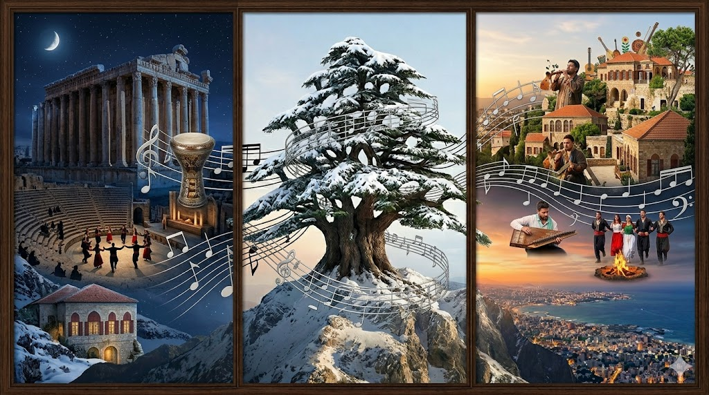

Slide 7


Slide 8


Ethical & Social Impact
Risks & Concerns
Positive Impact
•
Copyright Issues: AI-generated music or visuals may resemble to existing protected works.
•
High Accessibility
•
•
Cost Efficiency
Authenticity: Highly realistic AI media increasingly blurs the line between human-created and machine art.
•
Scalability: Allows independent creators to scale their output without needing massive studio resources.
•
Data Privacy: Utilizing personal data or voice samples requires strict consent and secure handling.

